Slide 1
Daily Expense Tracker
An AWS-Based Cloud-Hosted Expense Management
Application
Mini Project-Advanced Cloud Computing
Submitted by
Nivedita
Enrollment No.: PA2511CDH20
MS in Computer Science and Data Analytics
Indian Institute of Technology Patna

Slide 2
Problem Statement & Proposed Solutions
Problem Statement
Proposed Solution
1. Managing daily expenses manually can be difficult.
2. Users may lose track of monthly spending.
3. Identifying major spending categories takes time.
4. Staying within a monthly budget can be challenging.
1. A web-based Daily Expense Tracker.
2. Add, search and delete expense records.
3. View monthly spending summaries.
4. Visualise category-wise expenses using charts.

Slide 3
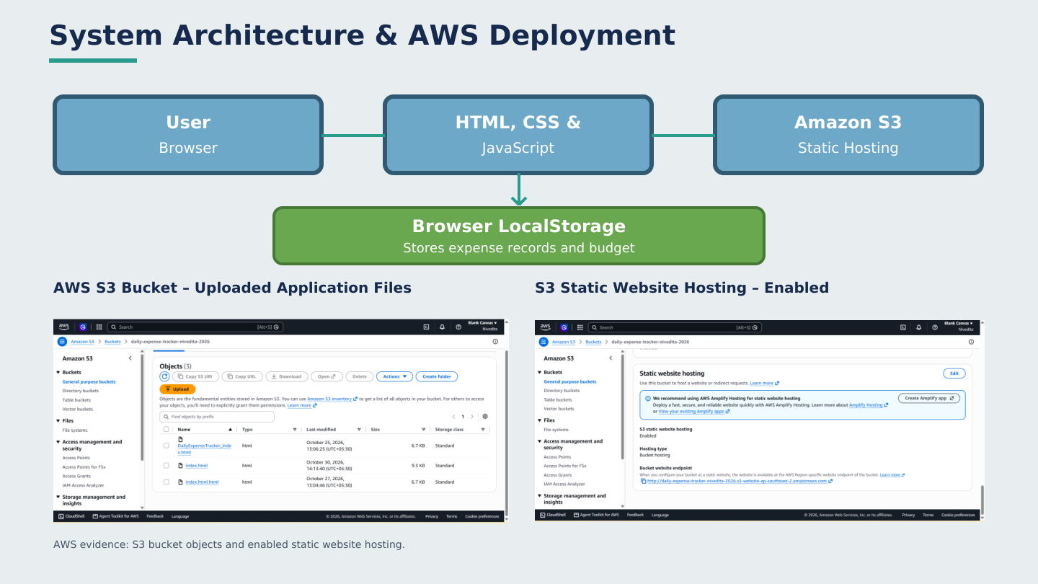

Slide 4
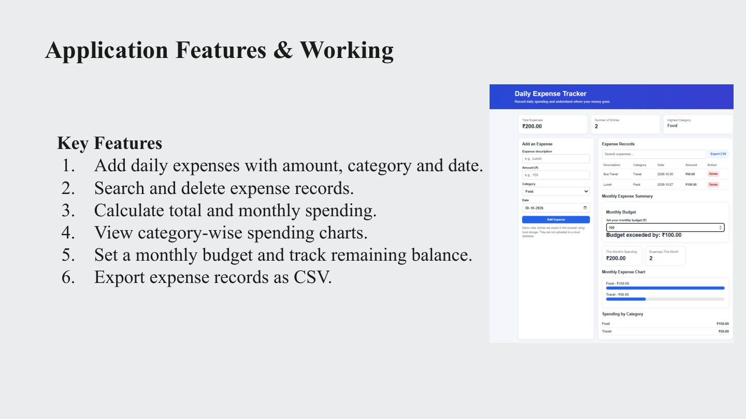

Slide 5
Results, Limitations & Future Scope
Results
Limitations
Future Scope
1. Successfully deployed the application on AWS S3.
2. Expense records can be added, searched and deleted.
3. Monthly spending and category-wise charts are displayed.
4. Budget tracking and CSV export work successfully.
1. Data is stored in browser localStorage.
2. No cloud database or user authentication.
3. Website uses HTTP static hosting.
1. Integrate Amazon DynamoDB for cloud data storage.
2. Add secure user authentication.
3. Enable monitoring and logging.
4. Improve security using HTTPS.

